Slide 1
Which is false?
Entity disambiguation addresses the problem of synonyms
Named entity recognition addresses the problem of synonyms
Entity disambiguation addresses the problem of entity classification
Named entity recognition addresses the problem of entity classification
Notes:
Answer B
Names entity recognition is a local method that extracts different entities from text independently. In standard NER the fact that different entities might share the names is not taken into account. However, NER performs classification into different entity types.

Slide 2
Which nodes cannot contribute to the score of a mention linked to a concept?
Other concepts linked to the same mention
Concepts that have in the knowledge graph no outgoing links
Concepts that have in the knowledge graph no incoming links
Concepts with low popularity
Notes:
Answer A
Concepts that have been linked to the same mention are competing for the interpretation. Therefore it is not meaningful to take them into account when trying to support an alternative interpretation.
One might wonder why Answer B and C are correct. A node with no outgoing link can still be the end of a path when computing PPR. Therefore it will contribute to the ranking. A node with no incoming link can on the other hand be the start of a path when comuting PPR and therefore contributes to the scoring.

Slide 3
Which is true? The score function f(h,r,t) …
has always larger values for triples (h,r,t) that are part of the known knowledge graph than for other triples
maps triples to vectors in the embedding space
is always positive
is optimized by stochastic gradient descent
Notes:
Answer C
The score function is a dissimilarity function that goes to zero when the facts are correct.
Answer A is exactly the opposite of the behavior of the score functions. As for Answer B, the score function maps tripes into real numbers, not vectors. And finally SGD optimizes the loss function not the score function.

Slide 4
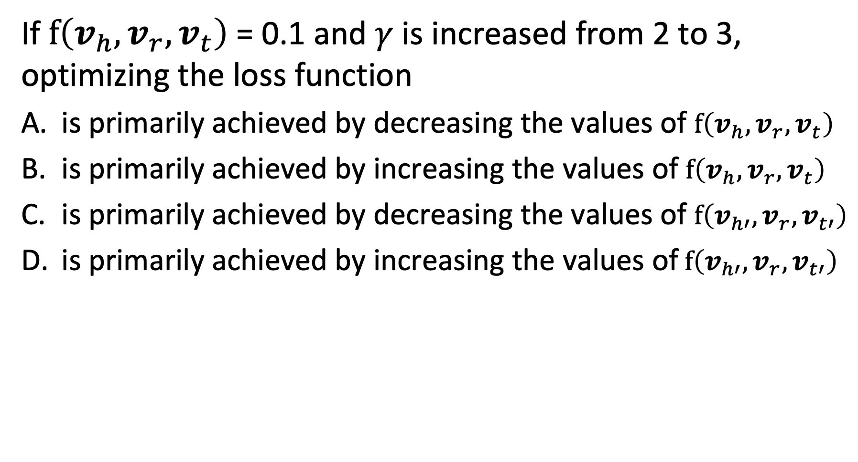
Question
If $f\left(v_{h}, v_{r},v_{t}\right)$ = 0.1 and $γ$ is increased from 2 to 3, optimizing the loss function
is primarily achieved by decreasing the values of $f\left(v_{h}, v_{r},v_{t}\right)$
is primarily achieved by increasing the values of $f\left(v_{h}, v_{r},v_{t}\right)$
is primarily achieved by decreasing the values of $f\left(v_{h′}, v_{r},v_{t′}\right)$
is primarily achieved by increasing the values of$f\left(v_{h′}, v_{r},v_{t′}\right)$
Notes:
Answer D
Since the score function for $f\left(v_{h}, v_{r},v_{t}\right)$ us already almost zero, the increase in margin can only be achieved by increasing the scores for the implausible triples, $f\left(v_{h′}, v_{r},v_{t′}\right)$.

